Slide 1
Overview of City of Portales 2021 Water Supply and Demand
Presentation to Portales City Council, Portales, NM
Charles R. Wilson, P.E.
December 2022

Slide 2
City of Portales Annual Water Conservation and Use Report
Documents water supply and demand trends
Evaluates effectiveness of water conservation measures
Provides information needed for effective water management
Meets NMOSE Grant Funding Requirements

Slide 3
The Need for Water Conservation
The aquifer providing the City’s water supply is being depleted and its high-capacity life has ended
Water right concerns have made supplemental water supplies from State lands less promising
Water deliveries from Ute Reservoir on the Canadian River are now more firm but may be 8 years away
It is important for Portales to continue to reduce water use and increase pumping capacity to bridge the gap until water from Ute or other sources is available

Slide 4
Changes from 2020 in Portales’ Blackwater Wellfield
The average aquifer thickness dropped another 2 feet
The average aquifer thickness at the City’s wells is now only 28 feet
Relief from imported Canadian River water is 8 years (or more) away
Portales’ 900 million gallon groundwater demand was unchanged from 2020
The City cannot afford many more years of 2 foot aquifer declines
Peak summer demands are already very difficult to meet
Four new replacement wells to be added in 2023 will help
Increased use of reclaimed water will help
But increased conservation awareness will also be needed to reduce demand to workable levels
Notes:
The Blackwater Wellfield is the City’s main wellfield.

Slide 5
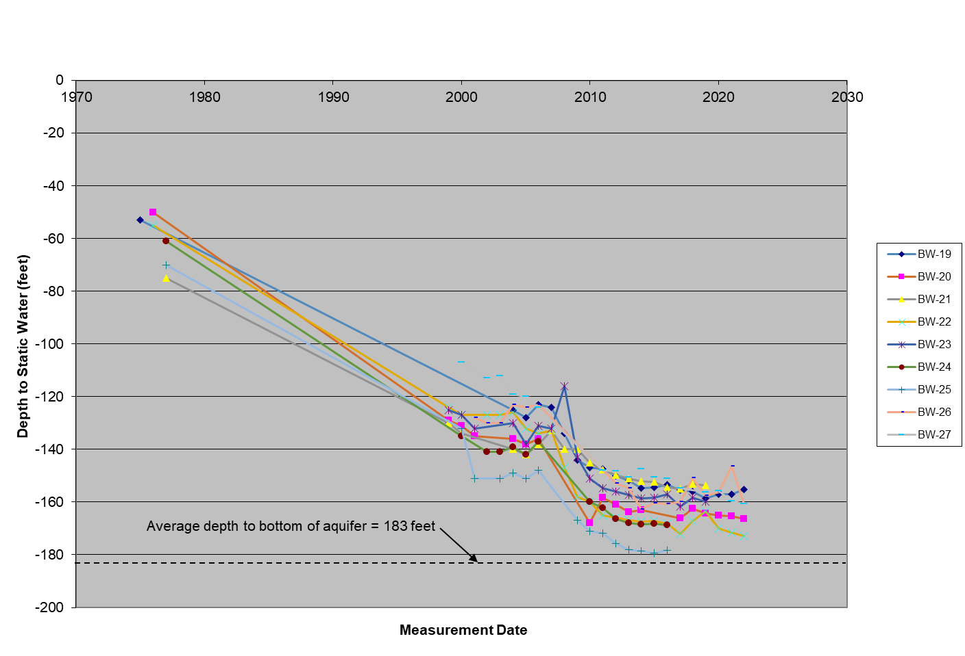
Need for Conservation: a Vanishing Aquifer Historic Water Level Declines in the Blackwater Wellfield Example Wells BW-19 to BW-27
Notes:
The depth to water was about 60 ft when these wells were drilled in 1975 but is now about 160 ft. Depletion rate is decreasing due to reduced well yield. You can’t pump the water out of the ground fast enough from a thin aquifer. The average aquifer thickness is now only 28 feet. Some water is still in the ground but it is much harder to get it out. The average aquifer thickness decreased by 2 feet in 2021.

Slide 6
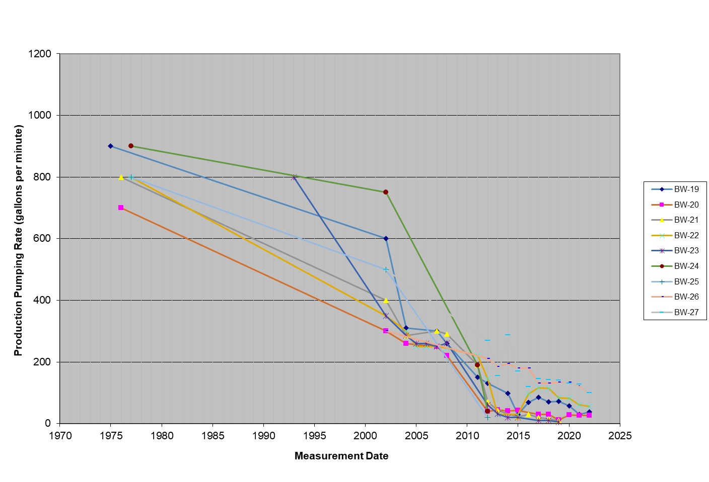
Need for Conservation: a Marginal Yield Historic Yield Declines in the Blackwater Wellfield Example Wells BW-19 to BW-27
Notes:
The yields of these wells was an amazing 800 gpm when they were first drilled. Now most have dropped below 100 gpm. Yields are dropping because it is harder to get the water to flow to the pump. Portales needs to continue to add more wells to maintain pumping capacity.

Slide 7
Bridging the 8-Year Gap: a Two-Pronged Approach
Increase supply through supplemental sources
Add new and replacement wells to the City wellfields
Increase the yields of existing wells
Use reclaimed water instead of well water
Eventually get renewable surface water from the Canadian River
Reduce demand through water conservation
Current overall goal is 40 million gallons reduction in demand each year
A renewed emphasis on water conservation is clearly needed
First we look at the supply side, then at the demand side, then at resolution
Notes:
It makes the most sense to decrease demand at the same time as increasing supply.

Slide 8
Supply Side Review of Two Important Trends: - Decreasing Aquifer Thickness results in - Decreasing Well Yields
Look at long-term average aquifer thickness trend in the Blackwater Wellfield
Example of long-term aquifer thickness and yield trends in BW-4
Look at declining production pumping capacity in Portales’ wellfields
Notes:
The aquifer is being pumped faster than it is being recharged. The aquifer is being mined for water that is not replaced. As the aquifer thickness drops, well yields also drop. Water will remain in some wells and go dry in those where the bottom of the aquifer is at a higher elevation.

Slide 9
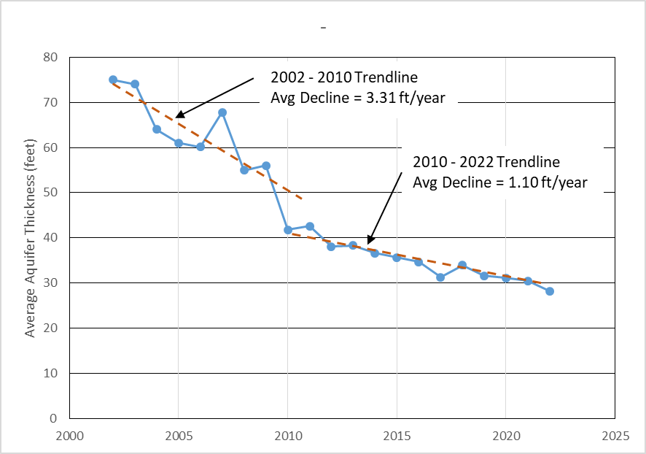
Average Aquifer Thickness at Blackwater Wellfield
Notes:
This is the average aquifer thickness of all the City’s Blackwater wells. The rate of decline is dropping because well yields are dropping and pumping is spread out among many more wells than before. The aquifer is now an average of 28 ft thick and water no longer flows quickly to the wells.

Slide 10
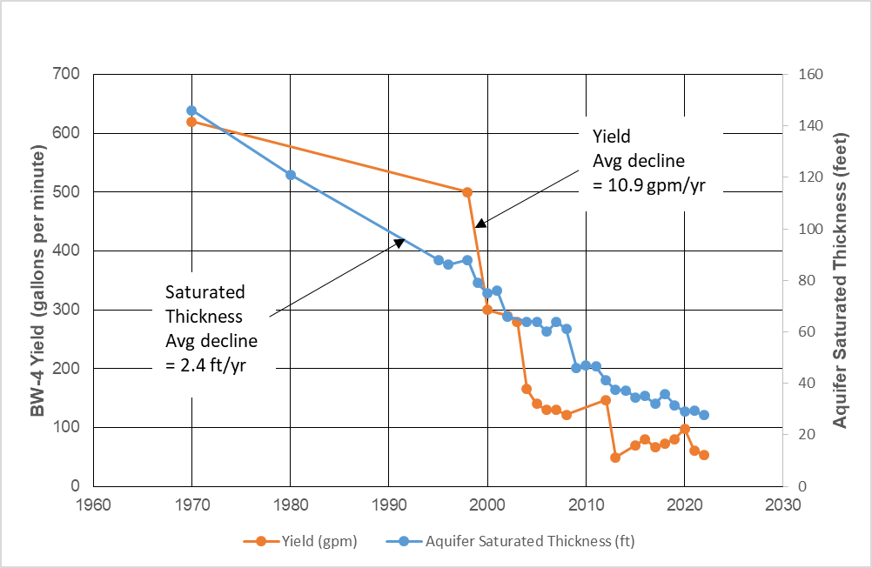
Example Saturated Thickness and Yield Trends in BW-4
Notes:
The saturated thickness in this well dropped from 140 feet in 1970 to 28 feet today. As a result, the yield dropped from over 600 gpm to 54 gpm today. And this is one of the City’s better wells.

Slide 11
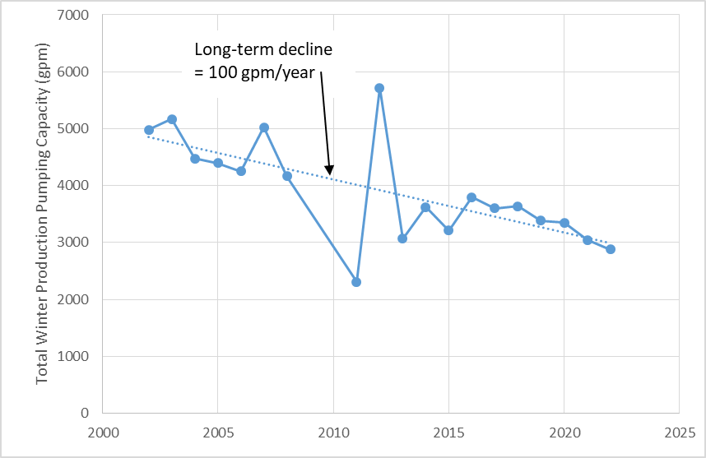
Total Production Pumping Capacity of Portales’ Wellfields
Notes:
The total production capacity of all Blackwater wells is dropping as it becomes harder to get the water out of the ground. The effect of this is first felt in summer water shortages. The ability to meet demands is the greatest immediate concern facing Portales.

Slide 12
Observations on the Water Supply Side
50 years of pumping the Blackwater wellfield has reduced
The average aquifer thickness from 140 feet to 28 feet
The average well yields from 600 gpm to 70 gpm
Portales had 42 Blackwater wells in 2021, of which 7 (17%) had negligible yields and were not pumped
Portales’ total pumping capacity has been declining for decades due to decreasing yields making it harder to meet peak summer demands
Overall, it is becoming increasingly difficult (and costly) to get the water out of the ground

Slide 13
Demand Side Review of Important Trends
Total wellfield demand has been dropping nicely since 2005, but
The demand has now leveled off at 900 million gallons, which is too high
In 2014 Portales adopted an ambitious target of reducing wellfield demand to 700 million gallons/year, but
This target was relaxed in 2018 when it appeared that additional water would soon be available from new wells on State lands
Now it appears that the additional water from State lands is only available in small amounts due to water right concerns, and
The City should reinstate ambitious water conservation measures to bridge the gap until Canadian River water is available or otherwise risk increasingly severe shortages
Notes:
At least now we have a firmer 8-year date for first Ute water delivery, but 2030 is still a long ways away and it is important to get through the gap while maintaining water supply at a reasonable level.

Slide 14
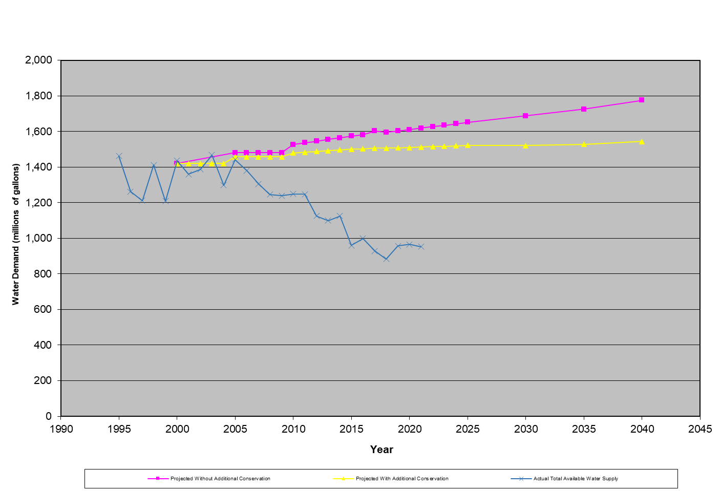
Total wellfield demand has been over 900 million gallons per year for the past 5 years – this is too high
Notes:
900 million gallons/year of well water may not be sustainable to bridge the gap. A 2014 analysis concluded 700 million gallons/year of well water plus 200 million gallons of reclaimed water would be better but these targets still need to be met. The progressive decline in demand needs to continue for at least the next five years.

Slide 15
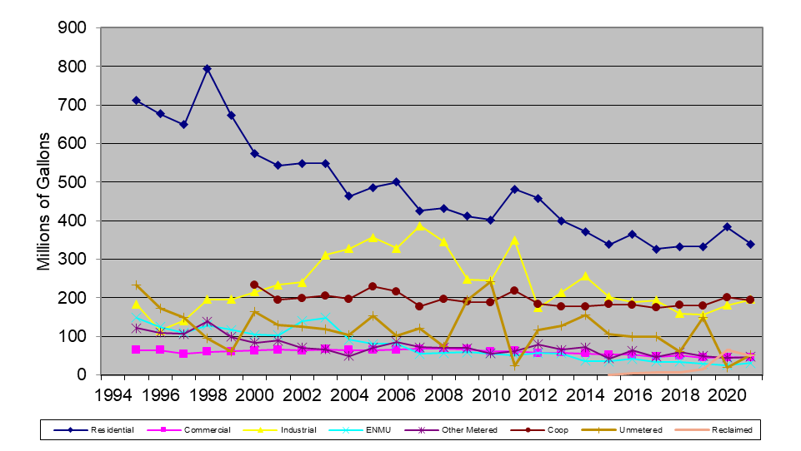
Long-Term Demand Trends by Category
Notes:
The continued stabilization of the three largest uses (Residential, Coop, and Industrial) is troubling. There are still 8 or more years to go before Portales will see Canadian River water.
ENMU, Commercial, and other (mainly City) uses were smaller and stable. This is good.
Reclaimed water use is barely visible but increasing. This is good.

Slide 16
Observations on 2021 Metered Water Demand by Category
The three largest water use categories (Residential, Coop, and Industrial) have the best potential for significant water savings
Residential use still has the best additional conservation potential.
Coop demand shows little sign of significant conservation over the past 20 years and should be reviewed for savings.
Industrial use is increasing and should also be reviewed for savings.
Unmetered uses (considered losses) are highly variable and difficult to control
Remaining Commercial, ENMU, other (mainly City) uses are low and stable
Reclaimed water use is growing and increasingly important

Slide 17
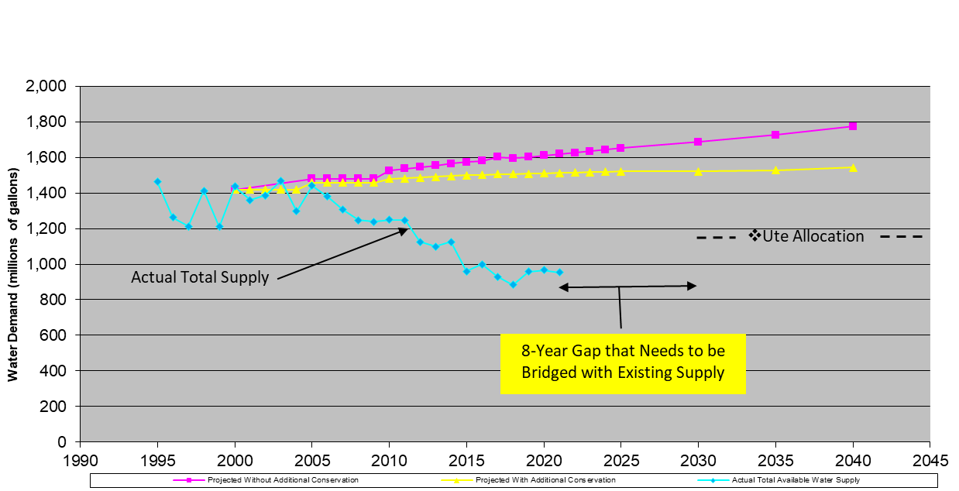
The Current Situation

Slide 18
The Path Forward
With a firmer Ute water delivery date of about 2030, Portales now has a more definite water supply gap to fill and can do more targeted planning
With the prospect of additional supplies on State lands looking less promising, the need to conserve remaining supplies has increased
The immediate problem is maintaining pumping capacity when drawing from an increasingly thin aquifer in the face of an increasing rather than a decreasing demand

Slide 19
Lower Demands = Lower Pumping Capacity Needed
Portales can maintain needed pumping capacity by:
Increasing wellfield production = more low yield wells = $$
Decreasing water demands = more conservation = social accommodation
Portales has the tools and the need to do both
Many effective Best Management Practices to reduce demands are described in Portales’ annual Water Conservation and Use Reports – Key actions are:
Increase conservation awareness in Portales
Increase water rates to discourage excessive use
Work with residents to reduce indoor and outdoor water use
Work with Roosevelt County Water Coop to develop a conservation plan
Work with industry to increase water conservation and reduce demands
Expand use of reclaimed water to replace well water
The supply gap may be upwards of a decade long and the possibility of a serious supply shortage is real and must be avoided

Slide 20
A final thought:
This is not a television show. The Canadian River will come to our rescue in the end but not before considerable cost and suffering unless the heroes of Portales step in and reduce water demands now.

